Slide 1
Web User Interface
Anish Kunduru Kellen Johnson Jonathan Osborne
Notes:
Introduce Yourselves!

Slide 2
Project Scope
Model a travel service utilizing the techniques learned in this class.
Modeled after kayak.com
HW5: Design Tasks
HW6: Communication Planning
HW7: Risk Assessment
Notes:
Speaker: Anish
The main goal for this project was to use the tools, techniques, and processes that we learned in this project management class to create the framework of a travel website.
We ended up modeling after kayak.com.
There were multiple components to this project. First, we had to create a plan for the development of similar user interfaces while addressing the needs of various stakeholders. This plan includes the identification of different design tasks, a communication model, and risk considerations.

Slide 3
Work Breakdown
Kellen Johnson
Jon Osborne
Anish Kunduru
Notes:
Speaker: Each talk about what we did.
Kellen Johnson: Reports, Resources, Stakeholders, Home and hotel screen sketches. Shortfalls, Budgeting, Software functions, and User Interface risks
Jon Osborne: Design Tasks, Interests, Supporting Elements, Communication Plan, Flight screen sketches, Gold Plating, Requirement Changes, Externally performed tasks.
Anish Kunduru: PDM Scheduling. Furnished Components, Real Time, and Capability risks. Cars and Packages UI sketches.

Slide 4
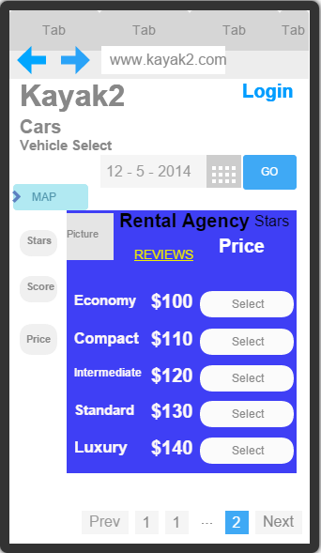
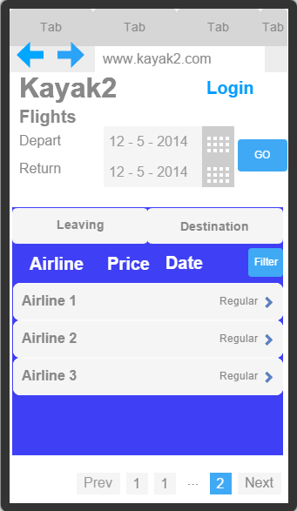
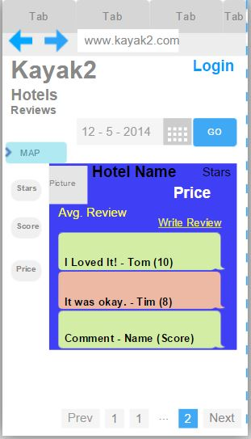
GUI Snapshots
Used Fluid UI online tool for sketches: https://www.fluidui.com
Notes:
Speaker: Kellen
We used FluidUI to design our user interface. FluidUI revolves mostly around mobile apps/websites but the simplicity of a mobile interface is good for making the overall UI more user-friendly.
An example of a car selection screenshot. After choosing a preferred car rental agency, the user is able to determine what type of deals are available for different types of vehicle. The user can also slim down shown items by entering a preferred price, user rating, and overall customer rating.
An example of a flight selection screen. After entering departure and arrival dates, the user will be shown several different airlines with flights matching that description. Much like the first screenshot.
Example 3 is a simple review screen. After selecting a specific hotel, a user is able to read existing reviews and write reviews for the given hotel. Reviews can be sorted by overall user score.

Slide 5
GUI Tasks
Home Page
Select hotels, flights, cars, or packages.
Hotels View
View all hotel details.
Compare hotels.
View & Create Reviews.
Flights View
Change the dates, location, or number of travellers.
Compare flights.
Get flight specific details.
Cars View
View different vehicle options.
View summary and complete registration.
Packages View
Display deal packages.
Notes:
Speaker: Anish
Home Page:
The home page is where you select hotels, flights, cars, and build your package. Upon visiting the site, you are given options to enter your destination, travel dates, and the number of people in your party.
Hotels View
This is where you can view all hotel details shows the map, photos, ratings, and reviews.
Compare results shows the different competitor’s prices.
The hotel view also enables users to view and create reviews.
Flights View
In the flight view, users can change the dates, location, or number of travellers.
Compare various airline prices and select a flight.
Get additional flight details like baggage fee information.
Speaker: Jon
Cars View
View different vehicle options. Economy, compact, intermediate, standard.
View itinerary summary and complete registration information. Add Rental car insurance.
Packages View
Display deals from Orbitz, CheapTickets, Travelocity, and others.

Slide 6
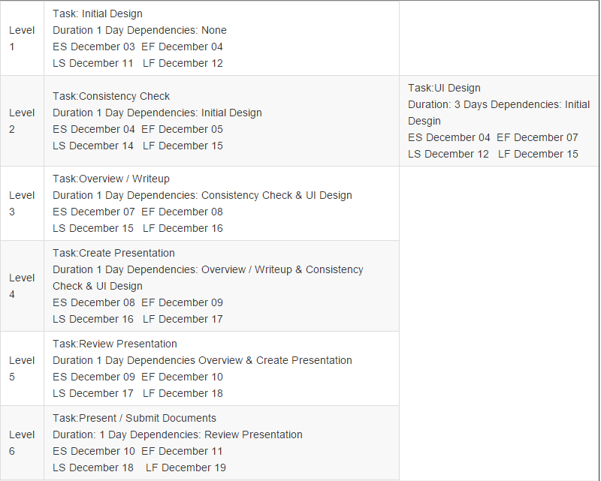
PDM Timeline
Identify objectives.
Identify infrastructure.
Estimate time.
Notes:
Speaker: Anish
A time precedence diagram is key for us to meet our estimated project completion date. So how do you create one?
First, we identified our project objectives.
Then, identified project infrastructure and characteristics.
After identifying the project products and activities, we estimated the effort needed for each activity.

Slide 7
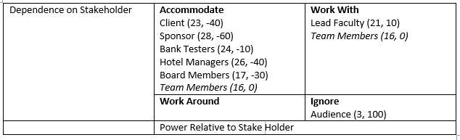
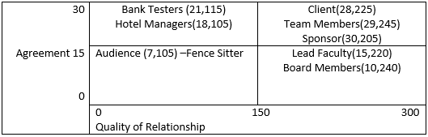
Communication
Stakeholders:
Team Members
Lead Faculty
Client
Sponsor
Board Members
Hotel Managers
Bank Testers
Audience
Notes:
Speaker: Kellen
Our communication plan is pretty standard in for a regular work communication plan.
Obviously, the most important people to keep in communication with in regard to usefulness would be Team Members and Lead Faculty Members.
Sponsor and client are a good need-to-know source for any problems that may arise in the project.
Board Members, Hotel Managers, and Bank Testers are all valuable parts of the project but mostly come down to the
finalizing of the project.
Audience is mostly irrelevant in regards to communication until the project is over and ready to be presented.

Slide 8
Communication - Resources
Remote Planning Resources:
Github https://github.com/SE329F15/Final-Project
Screen Sketches (FluidUI) https://www.fluidui.com
Google Docs (Presentation) https://docs.google.com
Notes:
Speaker: Jon
Github: Online repository for sharing documentation. Serves as website.
Screen Sketches (FluidUI): Contains drawings of routinely used elements found in screen designs.
Google Docs (Presentation): Slide show creation

Slide 9
Risks
Personnel Shortfalls
Unrealistic schedules and budgets
Developing the wrong software functions
Developing the wrong user interface
Gold Plating
Continuing stream of requirements change
Shortfalls in externally performed tasks
Shortfalls in externally furnished components
Real-time performance shortfalls
Straining computer science capabilities
Notes:
Speaker: Jon
Personnel Shortfalls : Unexperienced Developers, Lack of leadership
Unrealistic schedules and budgets : Hasty scheduling, Unforeseen obstacles
Developing the wrong software functions : Generality in design, Improper functionality
Developing the wrong user interface : Ergonomic design, Confusing features
Gold Plating : Unneeded enhancements to UI, Creation of features outside of scope
Continuing stream of requirements change : Client changes, Consumer feedback
Shortfalls in externally performed tasks : Logistical obstacles, Lack of client involvement
Shortfalls in externally furnished components : Use of open source projects, 3rd party payment services
Real-time performance shortfalls : Data Validation, Edge cases. API Interference with vendors.
Straining computer science capabilities : Lack of technical expertise

Slide 10
Questions?

